Slide 1

Learning PROJECT PRESENTATION ON “ HIRABLE AI – AN INTERVIEW TRAINER ”
SCHOOL OF ENGINEERING AND TECHNOLOGY
DEPARTMENT OF COMPUTER SCIENCE AND ENGINEERING
Presented By:
Nitin prasad Singh (24CSEAIML205)
Swadhin kumar Panda (24CSEAIML193)
Subhashree Panda (24CSEAIML197)
Class teacher
Mr. Sankar Patra
Dept. Of CSE,
GIET University , Gunupur

Slide 2
OUTLINES
S.NO. | CONTENTS | SLIDE NO.
1 | PROBLEM STATEMENT | 3
2 | INTRODUCTION | 4
3 | TECHNOLOGIES USED | 5
4 | NECESSARY DIAGRAMS | 6-7
5 | FEATURES | 8
6 | CHALLENGES | 9
7 | LIMITATIONS | 10
8 | SCREENSHOTS | 11-14
9 | CONCLUSION | 15
10 | FUTURE ENHANCEMENT | 16
11 | REFERENCES | 17

Slide 3
PROBLEM STATEMENT
Job aspirants lack access to personalized and structured interview preparation.
Existing interview preparation methods do not analyze resumes to tailor questions.
Candidates do not get company-specific and interview-type-based practice.
Manual interview feedback is time-consuming and often unavailable.
There is no automated system to evaluate answers and provide instant feedback.
Users cannot effectively track interview performance and progress over time.
The absence of an integrated AI-driven platform makes interview preparation inefficient.

Slide 4
INTRODUCTION
Hirable AI – An Interview Trainer is an intelligent platform designed to help job aspirants prepare effectively for interviews. The system focuses on improving confidence, communication, and interview performance through AI-based mock interviews. It consists of three main interfaces: Home Page, Mock Interview Page, and Dashboard. The Home Page allows users to upload their resumes for personalized preparation. The Mock Interview Page enables users to select a company and interview type. The Dashboard tracks performance and progress, helping users identify strengths and areas for improvement.

Slide 5
TECHNOLOGIES USED
Frontend (Browser): HTML, CSS, JavaScript
FastAPI: Resume upload, question generation, answer evaluation
Resume Parser & Chunking Engine: Resume analysis
Embedding Model API: Text-to-vector conversion
LLM Service: Question generation and answer evaluation
Database: Stores answers, scores, and history.

Slide 6
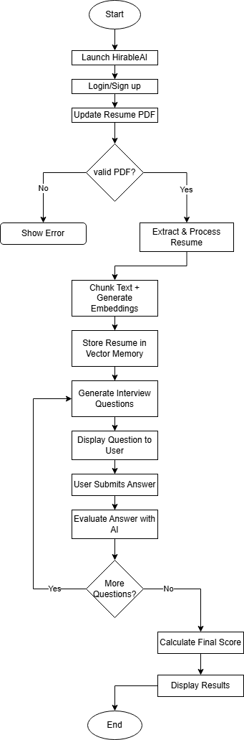
FLOW CHART

Slide 7
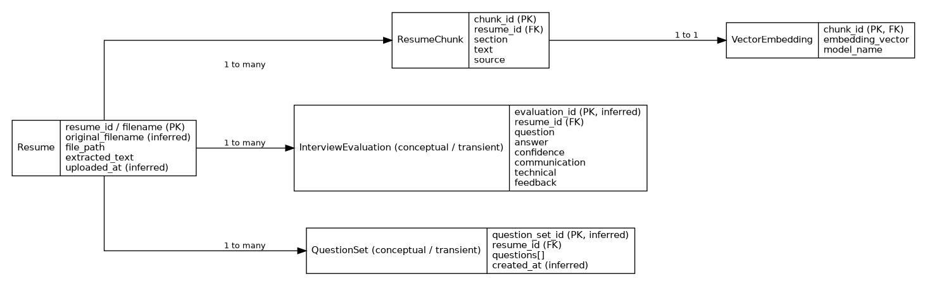
ER DIAGRAM

Slide 8
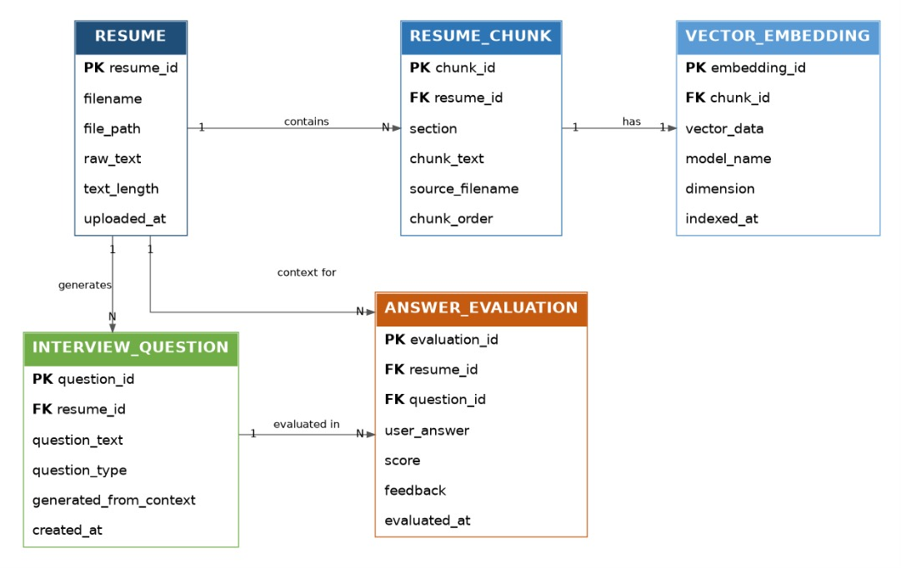

Slide 9
FEATURES
Resume upload and automatic resume parsing.
AI-based resume analysis using chunking and embeddings.
Personalized interview question generation based on resume content.
Company-wise and interview-type-wise mock interview selection.
Instant scoring and detailed feedback for each answer.
Secure storage of user responses and performance data.
Performance tracking through a centralized dashboard.
End-to-end automated interview training workflow.

Slide 10
CHALLENGES
Accurate extraction of skills and information from resumes with different formats.
Effective chunking of resume content without losing important context.
Generating high-quality embeddings that correctly represent user knowledge.
Efficient storage and fast retrieval of vectors from the vector database.
Maintaining relevance while generating interview questions using LLMs.
Ensuring fair and accurate evaluation of user answers.
Handling multiple API calls while maintaining low response time.
Managing session IDs and user state across different APIs.
Presenting complex evaluation results clearly on the dashboard.

Slide 11
LIMITATIONS
AI-generated questions and feedback may not fully match real interview scenarios.
Resume parsing may be inaccurate with poorly formatted or scanned resumes.
LLM evaluation can misinterpret context or nuances in answers.
System performance depends on stable internet and multiple API calls.
Limited human-like interaction and soft-skill assessment in mock interviews.

Slide 12
Conclusion
Hirable AI – An Interview Trainer is an effective AI-powered solution designed to enhance interview preparation and performance. By integrating resume analysis, intelligent question generation, and automated answer evaluation, the system provides a realistic and personalized mock interview experience. The use of FastAPI, vector databases, and large language models ensures efficient processing, accurate feedback, and scalable performance tracking. The dashboard enables users to monitor progress and identify areas for improvement. Overall, this application helps reduce interview anxiety, strengthen communication skills, and bridge the gap between academic learning and industry expectations, making it a valuable tool for job aspirants seeking to improve their employability.

Slide 13
FUTURE ENHANCEMENT
Enhanced Soft Skills Evaluation – Integrate voice and video analysis to assess communication, tone, and body language.
Adaptive Question Difficulty – AI can adjust question complexity based on user performance in real-time.
Integration with Job Portals – Suggest job opportunities based on resume and mock interview results.
Real-Time Collaborative Mock Interviews – Enable multiple users or mentors to conduct live mock interviews.
Offline Mode – Allow practicing interview questions and evaluating answers without constant internet.
AI-Powered Resume Improvement – Suggest edits and improvements to resumes automatically.

Slide 14
REFERENCES
FastAPI official documentation.
Python and numpy documentation for vector logic.
Large Language Model (LLM) APIs for NLP tasks.
Natural Language Processing concepts for resume analysis.
REST API architecture principles.

Slide 15
THANK YOU !

